Slide 1
Analysis of Docker From a Security Perspective
based on the research papers
‘To Docker or Not to Docker :A security perspective‘
and
‘Security Analysis and Threats Detection Techniques on Docker Container’
Abhijit S Iyer M21CS001
Poonam Kashyap M21CS012

Slide 2
Background
Over the last few years, the use of virtualization technologies has increased dramatically and as a result, the demand for efficient and secure virtualization solutions shoots up.
Container based virtualization and Hypervisor based virtualization (Virtual Machines) are the two main types of virtualization that have emerged to the market.
Container based solutions provide a more lightweight and efficient virtual environment.
Among all container solutions, Docker, a complete packaging and software delivery tool, is leading the market.

Slide 3
Background (contd.)
Docker security relies on three factors:
Isolation of processes at the user-space level managed by the Docker daemon
Enforcement of this isolation by the kernel
Network Security operations.
Docker is safe if used with default configuration. It provides isolation between containers and restricts containers' access to the host.
In contrast, widespread usages take advantage of options—given either to the Docker daemon on startup or to the command launching a container—that give containers extended access to the host. When used with untrusted containers, these options trigger many security concerns

Slide 4
Methodology
Docker provides users with many options to start and run docker images with various options, that expose the host system, the host network and other docker containers in vulnerable positions from which there may be no recovery.
In our implementation, we take a look at giving we take a look at giving the capability/ status of accessing the host file system to the Docker container with which will be able to access full authority over the specific directory of the host system.
mounting and unmounting of the host file system to the docker container,
executing privileged OS kernel instructions as the system administrator
changing the IP address and network mask of the host machine

Slide 5
Methodology (Contd.)
To start with, we wrote and built a docker image which runs a python application that tries to gain access to a directory present in the host’s file system, by reading content from a file and writing to a file in the same directory.
We then launched the image that was built using the following command:
docker run --volume "E:\Abhijit\MTech\Semester 1\Virtualization and Cloud Computing\Project\Code":/usr/app/src host_file_write_demonstration

Slide 6
Methodology (Contd.)
A file in the host system, named ‘File_from_Host.txt’ was created in the host machine with certain text written into it. Upon the creation of this container, the container with its privileges was able to read this file.
Similarly, a file was created by the container and was placed in the host’s file directory with some content written to this. This shows the two way access that a container has over the host system’s file directory. It also demonstrates a vulnerable security flaw in the docker system.

Slide 7
Results & Analysis
From the experiments done, it was observed that the Docker container was able to gain full access to the file system of the host computer, which puts many critical files and folders of the host system at a high risk of being compromised by a container.
This is because Docker Engine can be run with root privileges, and hence if a process breaks out of the container, it will have the same privileges as a system administrator. Therefore, we need to be extremely careful about the privileges that we give a container during its execution.
A container is not a trust boundary. The only difference between a normal process that runs in the system and a docker container process is the metadata that declares it as a container process.

Slide 8
Results & Analysis
We can control the container from getting any sort of root privileges by provisioning it with a User ID (UID) or a Group ID (GID), which can be supplied to the container by making it a part of the dockerfile.
It’s been detected that thousands of Docker images present in DockerHub have critical vulnerabilities, which may give enough cues for attackers to attack critical systems and expose critical data.
It was also observed that applications being hosted by the container and the libraries that are present in the container also put other containers and host systems at high risk of direct and indirect adversaries.

Slide 9
Results & Analysis
Using Docker containers for automated build systems creates another security flaw i.e. When changes are pushed to a github repository, an automated build system would be triggered through Jenkins which would build an image and immediately push it to Docker Hub within a span of 5 to 10 minutes. This is again a highly risky methodology because the image would not have been checked for vulnerabilities and is directly being pushed onto production.
Docker by default does not expose security vulnerabilities, it does allow users to take advantage of the available features in docker daemon to be utilized and put important components of a system such as file system, network configurations, kernel parameters at high risk.

Slide 10
Results & Analysis
Security of Docker components such as Docker clients, daemon and Register and their collective activities which creates vulnerabilities in case of existence of some exposures. Based on following aspects :
Container Escape Attacks
Sensitive Information Leakage
Network Mode Security
Existing Security Mechanism for Docker Container includes resource isolation, resource control, kernel capabilities are utilized for security enforcement.
Docker also allows developers to make use of third party plugins such as Snyk, that scans existing images for vulnerabilities.

Slide 11
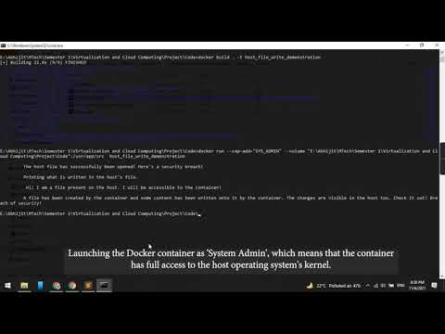
Demonstration

